Slide 1
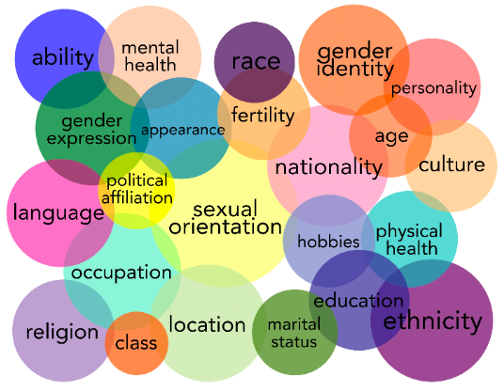
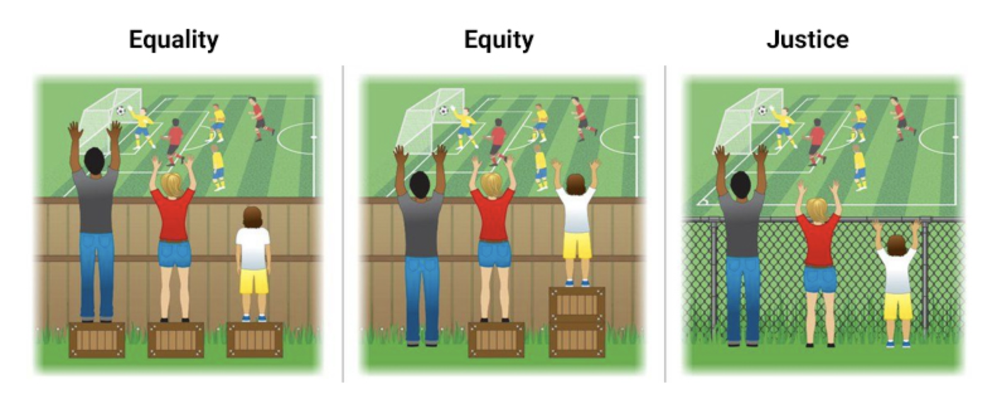
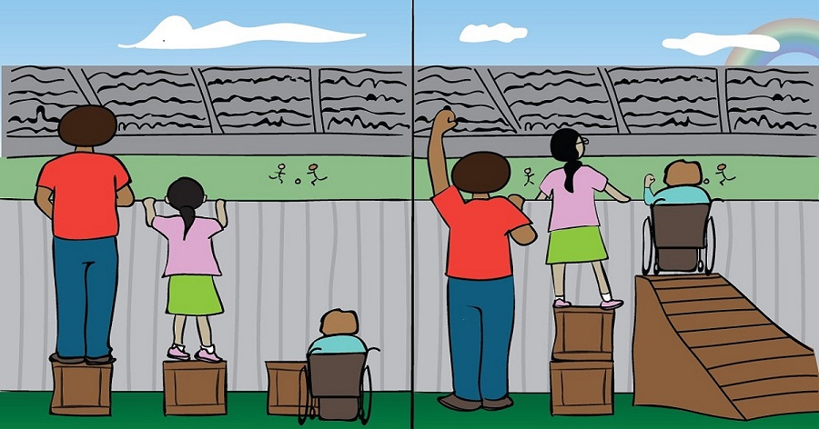
Gender Equity in STEM
For the purpose of this talk, we are going to focuses our lens on women in science, technology, engineering, and mathematics (STEM) – while acknowledging that the majority of data available comes from white or Asian women due to the widespread underrepresentation of racial and ethnic minorities in STEM.
For people with multiple intersectional identities the barriers they experience could be compounded and more extreme.
While gender equality is simply focused on providing men and women with the same equal opportunities (like making it legal for women to own land, or even attend school), gender equity works to correct the historical wrongs that have left women behind (such as societal restrictions on employment).
-Agnes Binagwaho, Forbes Commentary
Equality
Equity
Systemic barriers and inequities have been addressed and all 3 can see the game without supports or accommodations.
Photo Source: http://muslimgirl.com/46703/heres-care-equity-equality/
Photo Credit: https://www.surfertoday.com/bodyboarding/equity-versus-equality-in-womens-bodyboarding
Notes:
I would like to acknowledge that the intersectionality of race, gender, ethnicity, and socioeconomic backgrounds makes it extremely difficult to talk about one barrier without talking about several because individuals are multidimensional in their experiences, identities, and backgrounds.
So today my talk will cover some of the overarching barriers that appear to impact women in STEM in general, occasionally highlighting where these intersectionality's might be impacted most.
Agnes BIN-A-GuA –WA –HO (Rwandan pediatrician and currently the Vice Chancellor of the University of Global Health Equity)
WHAT IS THE CURRENT ENVIRONMENT WE SEE IN STEM?

